Slide 1


Social buzz
Insights

Slide 2


Today's agenda
Project recap
Problem
The Analytics team
Process
Insights
Summary

Slide 3

Social Buzz is a fast growing technology unicorn that need to adapt quickly to it’s global scale. Accenture has begun a 3 month POC focusing on these tasks:
An audit of Social Buzz’s bid data practice
Recommendations for a successful IPO
Analysis to find Social Buzz’s top 5 most popular categories of content
Project Recap

Slide 4

Problem
Over 100000 posts per day
36,500,000 pieces of content per year!
But how to capitalize on it when there is so much?
Analysis to find Social Buzz’s top 5 most popular categories of content

Slide 5



Andrew Fleming
Chief Technical Architect
The Analytics team
Marcus Rampton
Senior Principle
Noonsavath Nithin
Data Analyst

Slide 6
Process
1
Data Understanding
2
Data Cleaning
3
Data Modelling
4
Data Analysis
5
Uncover Insights

Slide 7

Insights
Over half of the content generated in 2020 contributed to the Social Buzz platform's dynamic ecosystem.

Slide 8
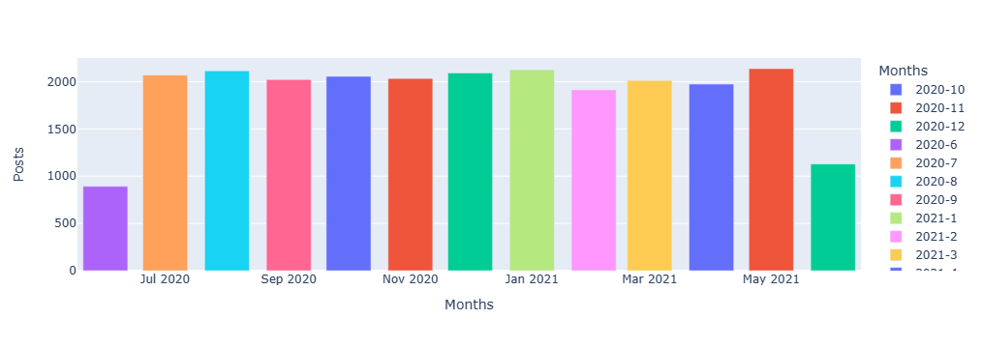
Month with the Most Posts
In May 2021, Social Buzz experienced its highest volume of posts, marking a significant peak in user engagement.

Slide 9

Most 5 Popular Categories
"The top category on Social Buzz, animals content, dominates user engagement, reflecting a widespread interest in adorable and captivating animal content."

Slide 10

Unique Categories
Social Buzz boasts a diverse range of content categories, with a total of 16 types captivating users' interests and sparking engagement across the platform.

Slide 11

Most Reactions for Popular Categories
CATEGORIES | REATIONS
ANIMALS | 1897
SCIENCE | 1796
HEALTHY EATING | 1717
FOOD | 1699
TECHNOLOGY | 1698
The captivating world of animals on Social Buzz garners a remarkable 1,897 reactions, demonstrating its immense popularity among users.

Slide 12


Comprehensive overview of Social Buzz's data landscape and strategic objectives
Key insights on content generation trends, post frequency, and popular categories
Actionable recommendations to enhance user engagement and drive platform growth
Strategic roadmap for leveraging data best practices and preparing for a successful IPO
Positioning Social Buzz for continued success in the dynamic social media landscape
Summary

Slide 13
Thank you!
ANY QUESTIONS?

